Slide 1

ST. FRANCIS COLLEGE
MCA DEPARTMENT
MINI PROJECT PRESENTATION ON
“TEMPERATURE BASED AUTOMATIC FAN CONTROL AND MONITRING SYSTEM”
PRESENTED BY:
SANJANA M (P18IW21S0017)
SHREYAS K M (P18IW21S0022)
UNDER THE GUIDENCE OF:
Dr. CHETHANA SRIDHAR
Assistant Professor

Slide 2


TABLE OF CONTENTS
ABSTRACT
PROBLEM STATMENT
OBJECTIVE
SYSTEM REQUIREMENTS
CONCLUSIONS
FUTURE ENHANCEMENT

Slide 3

ABSTRACT
The project works by continuously measuring the temperature and humidity using a sensor. It compares the temperature to a threshold value set by the user through the app. If the temperature is below the threshold, the fan is turned off. If the temperature exceeds or reaches the threshold, the fan is turned on to cool the environment.
The system also provides real-time temperature and humidity readings on the app, so users can keep track of the current conditions. They can adjust the threshold value through the app, allowing them to customize when the fan should turn on or off.

Slide 4

PROBLEM STATEMENT
In many environments, maintaining an optimal temperature is crucial for comfort and productivity. However, manually monitoring and controlling a fan based on temperature fluctuations can be inconvenient and inefficient. It requires constant monitoring and adjustment, especially when the temperature changes frequently. Additionally, there may be situations where individuals are unable to physically access the fan to turn it on or off.

Slide 5
OBJECTIVE
The system aims to provide a convenient and efficient way to maintain a comfortable environment by turning on the fan when the temperature exceeds a user-defined threshold and turning it off when the temperature is below the threshold value.
To develop an low cost, user friendly automated temperature controlled fan which reduces power consumption.
Enable remote monitoring and control of the system through a user-friendly interface, allowing users to view real-time temperature and humidity readings, adjust the threshold value.
The Fire Detection and Alert System project is to develop a reliable and real-time fire detection system that can promptly detect the presence of fire and alert users.
The project considers the needs of individuals with disabilities by ensuring an accessible user interface and incorporating features that facilitate easy control and monitoring. This promotes inclusivity and enables people with disabilities to effectively utilize the system

Slide 6






SYSTEM REQUIREMENTS
HARDWARE REQUIREMENTS
SOFTWARE REQUIREMENTS
ESP8266 development board (NodeMCU)
DHT11 temperature and humidity sensor
KY-026 Flame Sensor
Relay module (for controlling the fan)
Buzzer module (optional, for audio alerts)
Jumper wires
Breadboard or prototyping board
Power supply (12V DC) for Fan
Fan or motor
Arduino IDE (Integrated Development Environment)
ESP8266 board package for Arduino IDE
Blynk mobile application (available for iOS and Android)
Blynk library for Arduino IDE
DHT library for Arduino IDE
Windows 10

Slide 7
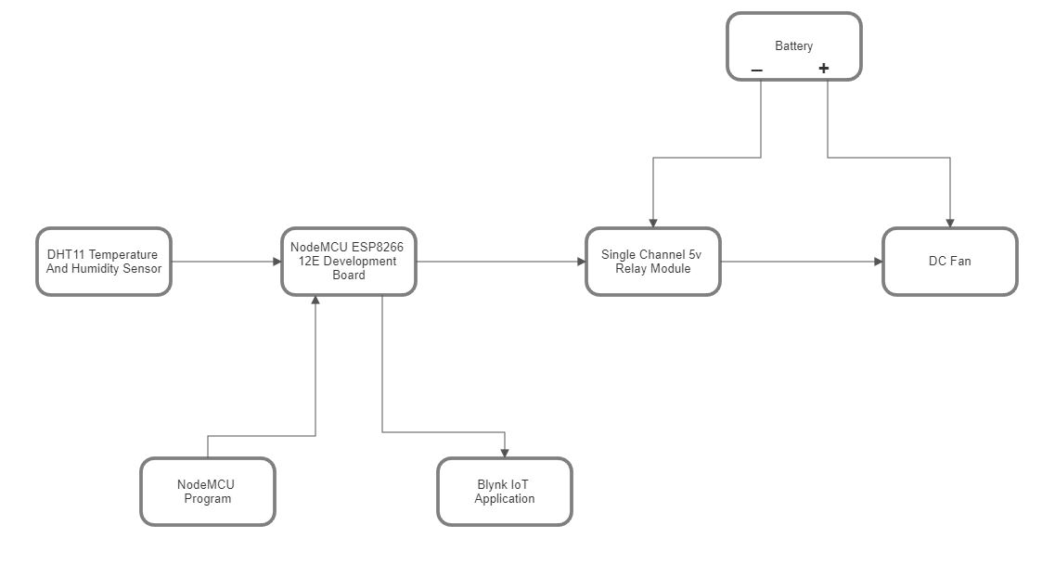
BLOCK DIAGRAM

Slide 8
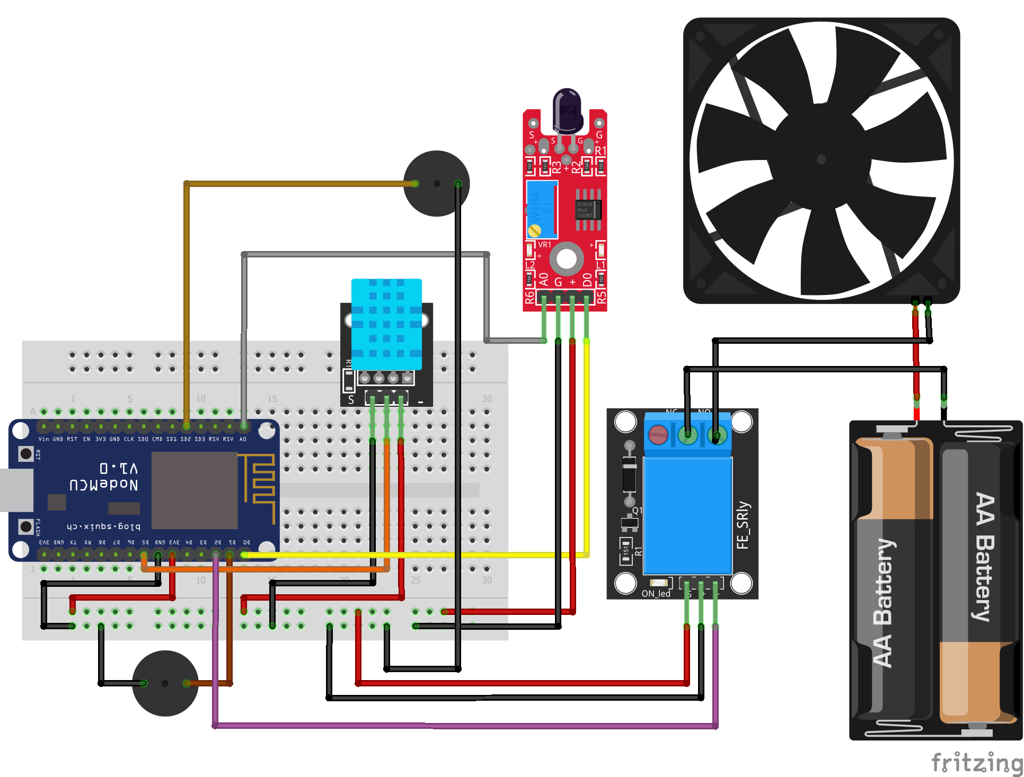
CIRCUIT DIAGRAM

Slide 9

Sensor Placement: The placement of the temperature sensor can impact the accuracy and effectiveness of the temperature control system. Ensure that the sensor is positioned in a representative location to monitor the desired temperature accurately.
LIMITATIONS
Environmental Factors: Environmental conditions, such as extreme temperatures, humidity, dust, or corrosive substances, can affect the performance and longevity of the fan and other components. Ensure that the system is designed and protected adequately to withstand the environmental conditions in which it will be deployed.

Slide 10


CONCLUSION
Through the smartphone app, users can easily set the desired temperature threshold, monitor real-time temperature and humidity readings, and remotely control the fan. This feature allows users to maintain a comfortable environment from anywhere, enhancing convenience and flexibility.
And real-time fire detection system that can promptly detect the presence of fire and alert users. The system aims to provide an early warning mechanism to mitigate the risks associated with fire incidents and enable users to take immediate actions to ensure safety and minimize potential damage.

Slide 11

FUTURE ENHANCEMENT
It does not support fan speed control. However, by incorporating an L298 2A Dual Motor Driver Module with PWM control, it is possible to overcome this limitation and enable precise control of the fan speed.
One possibility is to leverage external control systems or microcontrollers that can handle a larger number of pins and provide more processing power. These systems, such as Raspberry Pi or ESP32, offer increased capabilities and flexibility for integrating multiple components without sacrificing the ability to control the fan effectively.

Slide 12
THANK YOU!

